Slide 1
Type Go
“A game which test and improves typing”

Slide 2

AGENDA
➔ INTRODUCTION
➔ FEATURES
➔ WORKING
➔ CHALLENGES
➔ FUTURE WORK

Slide 3
INTRODUCTION
The project aims to develop a Typing speed game .
Type-go helps to test and improve the typing speed of a person.
It is multiplayer game.
one can create or can join the room created by their by friend.

Slide 4
FEATURES
A multiplayer game .
User can create or join rooms
Improves typing skills
Validation

Slide 5
FEATURES
Test typing speed with wordcount per minute.
Interacts with your friends.
Clean user’s interface.
A responsive UI

Slide 6
HOW IT WORKS?
It starts with interactive user interface in which
a player have two options he can create a new
room or can join a room with specific room id
given by their admin friend.
If a player creates room with a id that is already in a ongoing process then it will show error that a game is already in a running process with this id.
After successfully joining of all players the admin start
the game by clicking on start button.

Slide 7
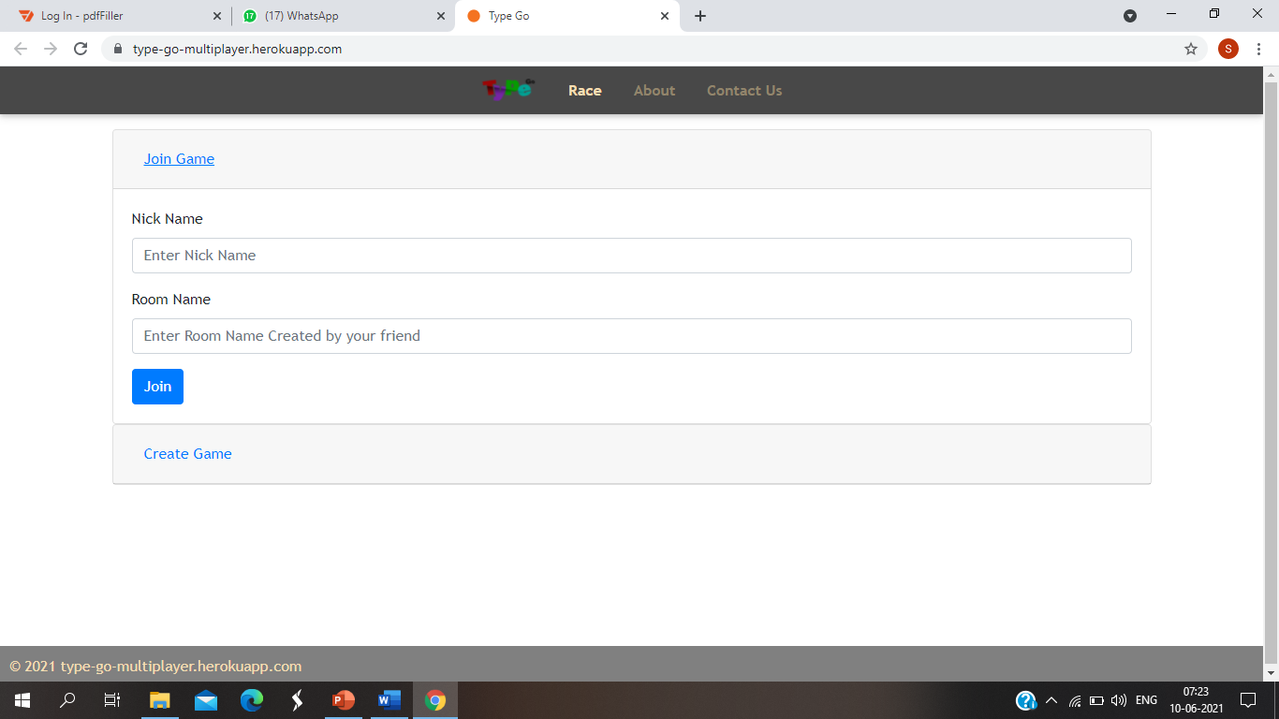

Slide 8
WORKING
After the games the starts all players will get display a same paragaraph of 4-5 lines and they can also see each other’s progressive bar which will be increasing as they writes paragraph and when game finishes all player can see each other’s results with wordcount per minute.However If the admin left the game due to any reason the game will stopped there and other user will display with a message(Admin left the game).

Slide 9
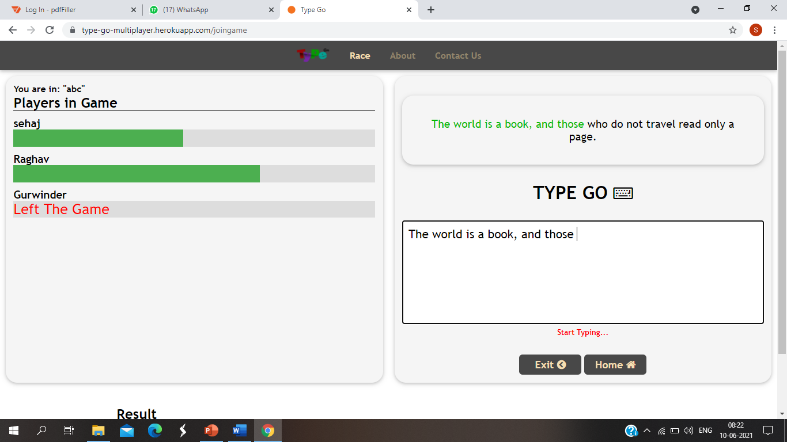

Slide 10
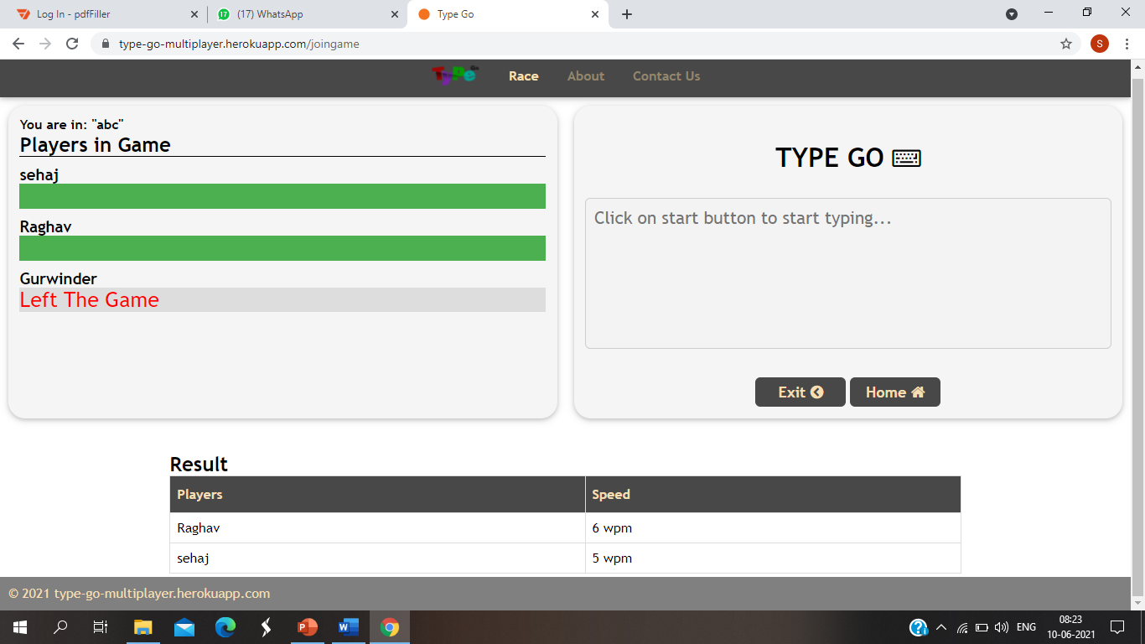

Slide 11
CHALLENGES FACED
★ Handling in create and joining room logics.
★ working on socket programming

Slide 12
FUTURE WORK
categorising according to user’s interest like simple texts , codings etc
categorising in to level like Beginners, Intermediate, Masters

Slide 13
THANK YOU . . .
Sehaj chawla
Raghav Kapoor
Gurwinder singh

